Slide 1

PRATIBHA
BAJORIA

Slide 2
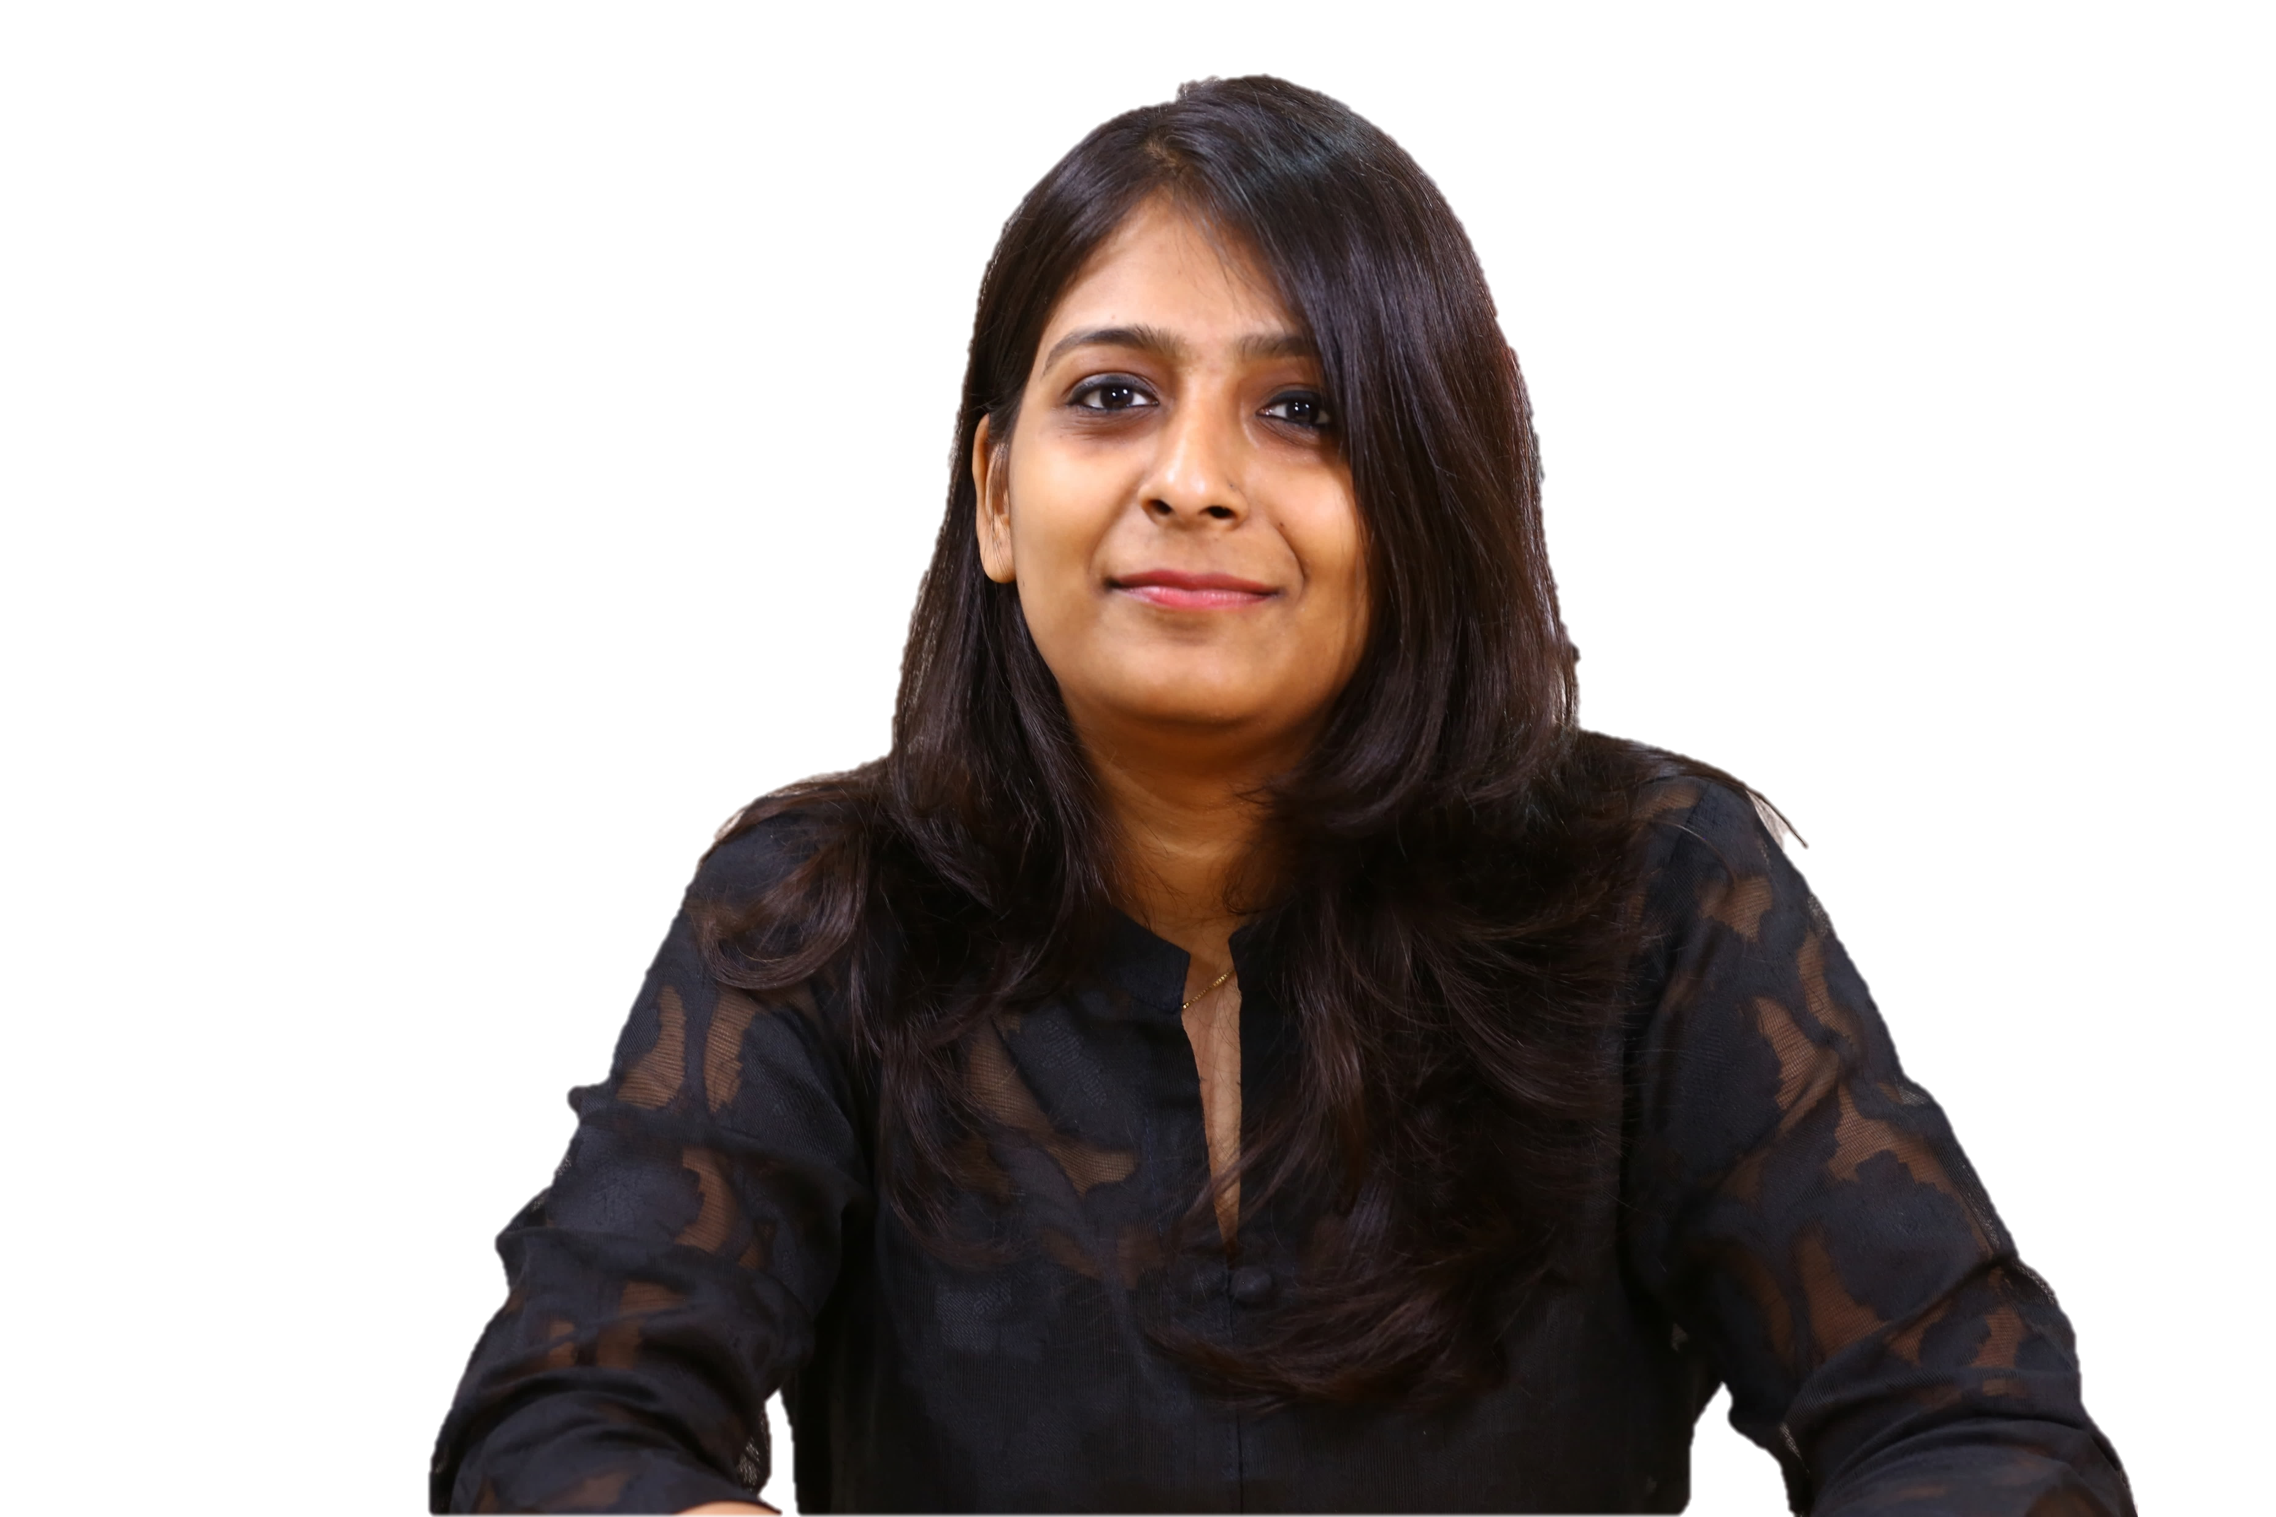
ABOUT PRATIBHA
Pratibha is a result oriented, learning enthusiast who strategizes in innovative life-cycle marketing campaigns and media solutions for Brands to drive business growth.

Slide 3
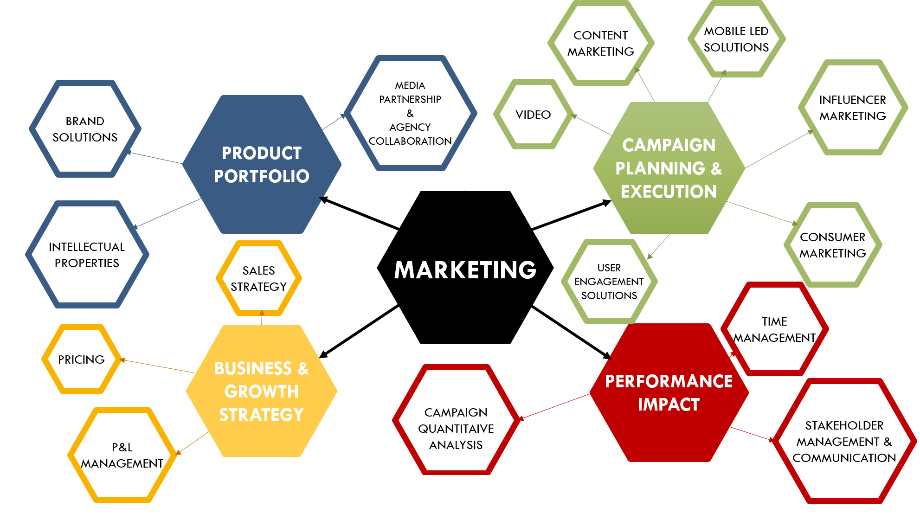
AREA OF MY UNDERSTANDING

Slide 4
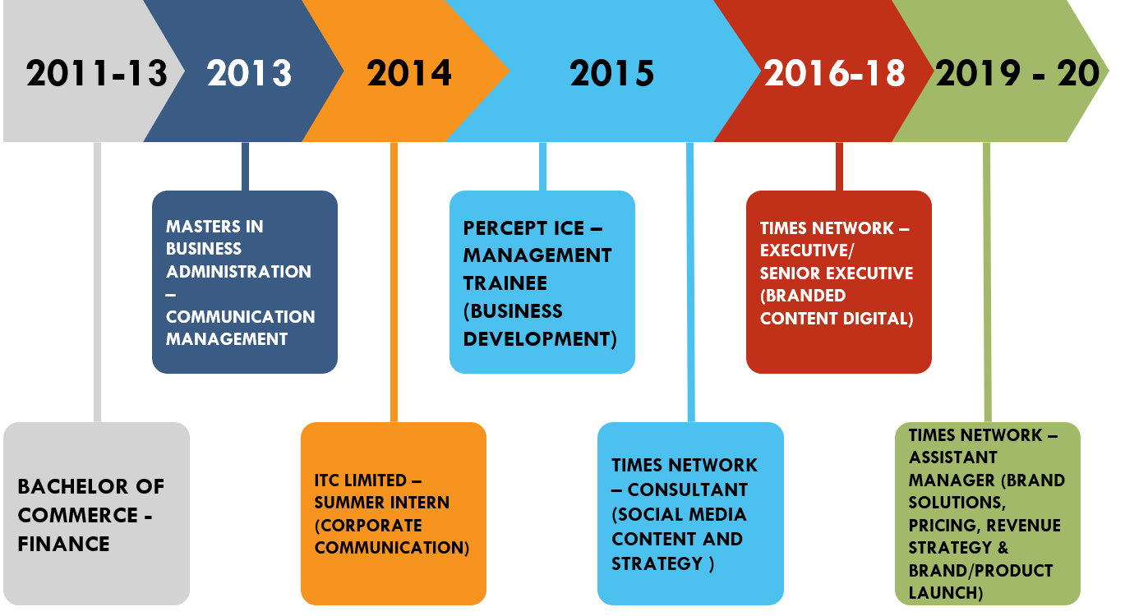
EDUCATION & PROFESSIONAL BACKGROUND AT A GLANCE
5 years of experience in strategy formulation, marketing and media planning, execution, brand solutions as well as integrating innovative marketing campaigns to maximise business revenue.
5 years of experience in designing & executing consumer marketing campaigns leading to the entire process of concept development, media planning and execution.
Handled marketing campaigns using organic and paid media assets with budgets ranging from USD 20k to 150k, targeting both B2B & B2C markets, thereby increasing the business growth by 33%.
Assisted in the brand launch of IPs pertaining to brand vision, objectives and customer experience.

Slide 5
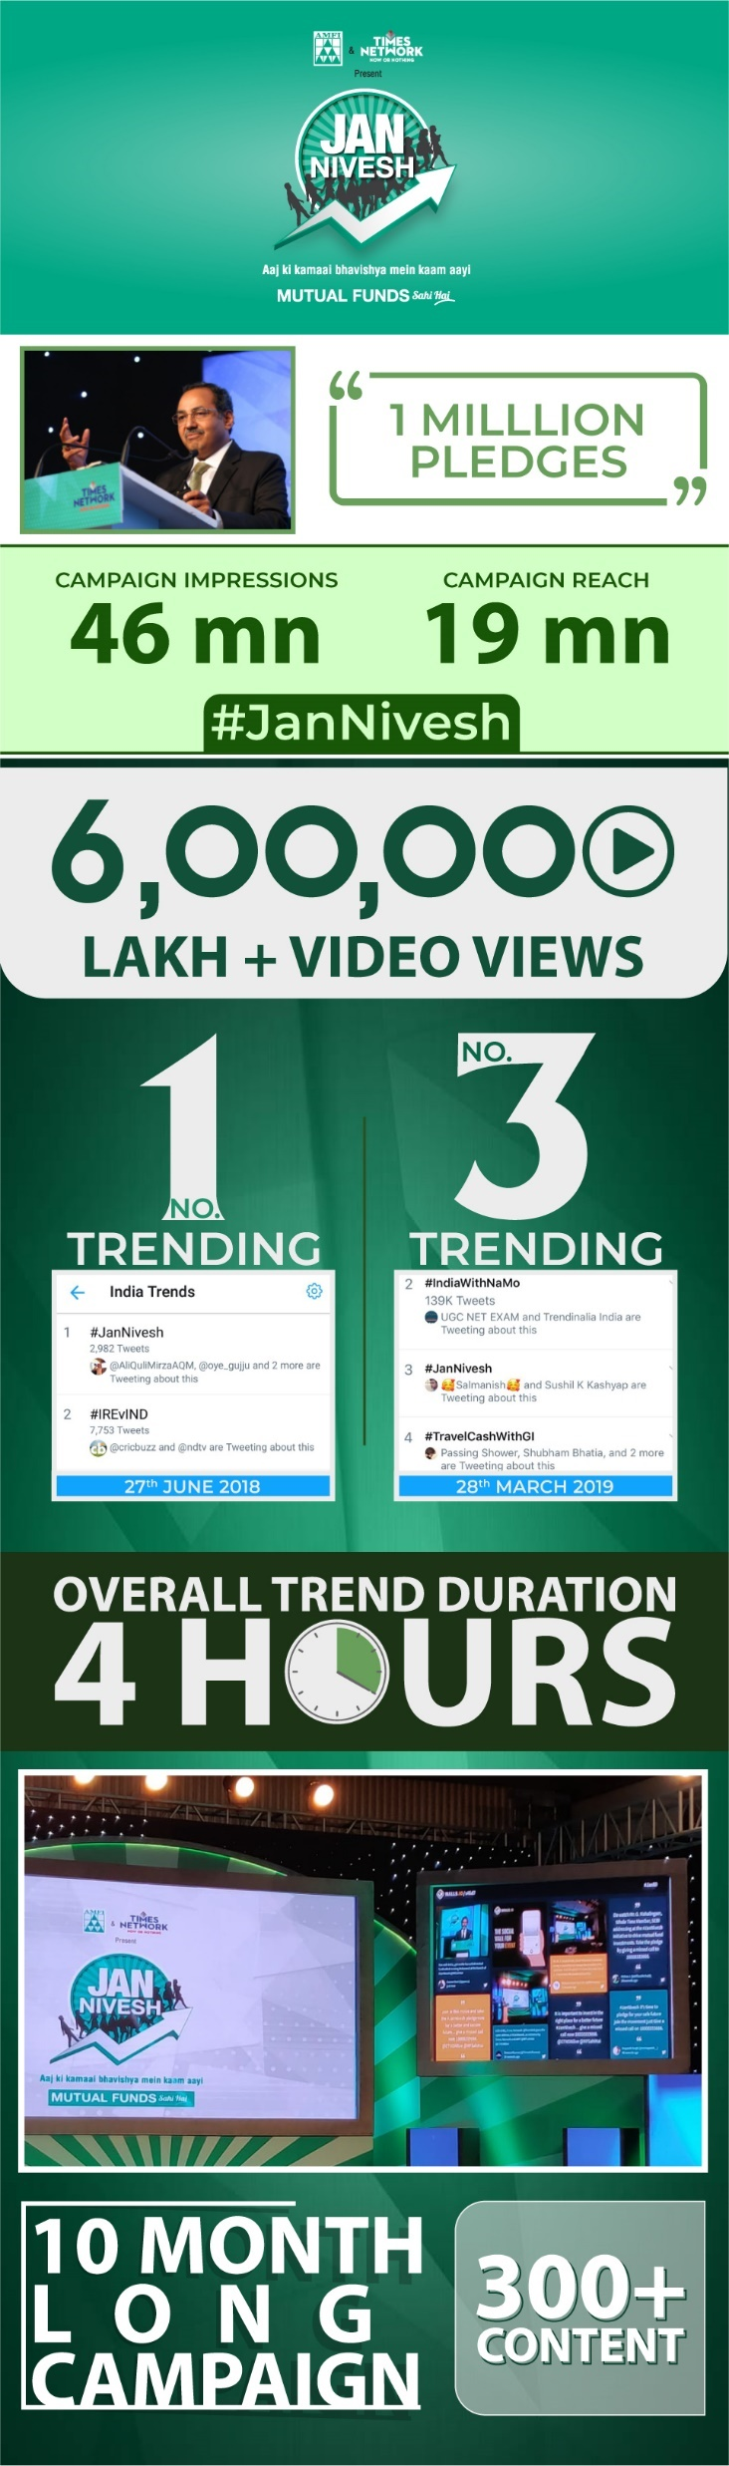
CASE STUDY 1
JAN NIVESH
CAMPAIGN IDEA: – TAKE A PLEDGE TO INVEST A DAY’S INCOME EVERY MONTH IN MUTUAL FUNDS
CLIENT: ASSOCIATION OF MUTUAL FUNDS IN INDIA
Pratibha was the lead project manager for the Jan Nivesh campaign responsible for the implementation and execution of the program to create brand awareness and deliver the key communication consistently across India
SITUATION
TASK
The challenge was to define the pledge measurement of awareness in Tier 2 and Tier 3 cities using a simple methodology
Pratibha, along with the team came up with a missed call mechanism to drive the pledges with an integrated API on the microsite to factor one call as one pledge. A simplistic approach to reach out to the customers in India
ACTION
RESULT
Within 9-10 months, the team achieved 1 mm unique pledges using the missed call number with an overall campaign reach of 46 mm only on digital

Slide 6
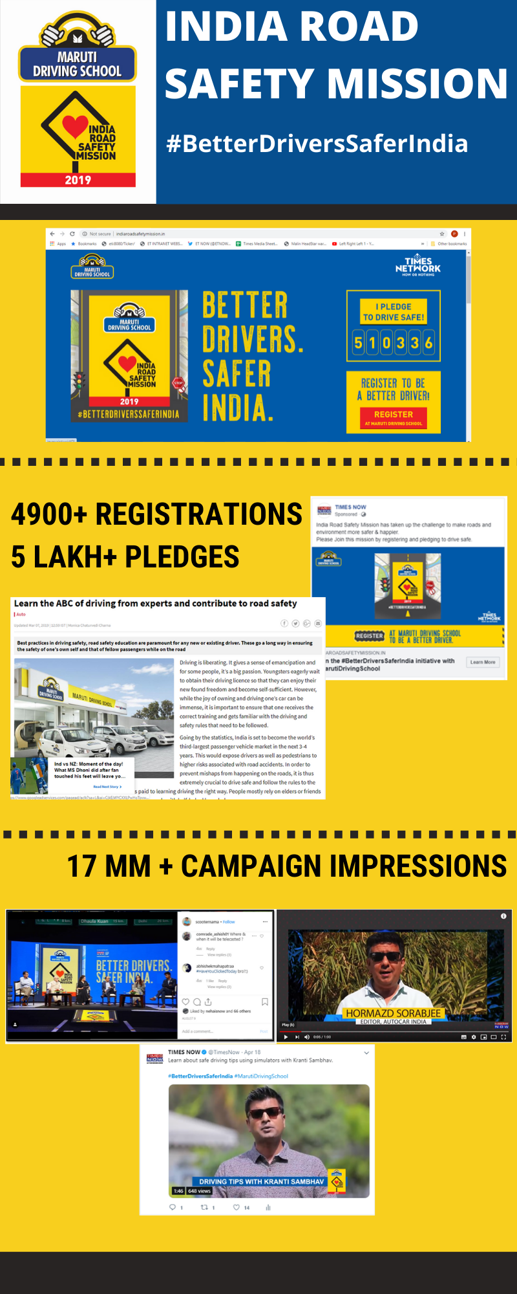
CASE STUDY 2
INDIA ROAD SAFETY MISSION
CAMPAIGN IDEA: – TO ENCOURAGE BETTER DRIVING FOR A SAFER INDIA
CLIENT: MARUTI SUZUKI
Pratibha was given the responsibility to manage the overall marketing campaign with the media operations team that specializes in lead generation campaign to achieve the set KPIs and maintain the topline investment
SITUATION
The accuracy of data entries using the OTP feature as an additional step was showing an exponential increase of media spends by a minimum of 60% than the set value. (A requirement set by Maruti after the deal was signed)
TASK
As a team effort including all the internal stakeholders, an audience management agency was hired to manually call the people from the database to determine the accuracy of the leads achieved,to minimise the media spends and maintain topline revenue
ACTION
RESULT
The team achieved a minimum of 4000 leads with an accuracy rate of 80% in 2.5 months leading to client retainership for the year 2020.

Slide 7
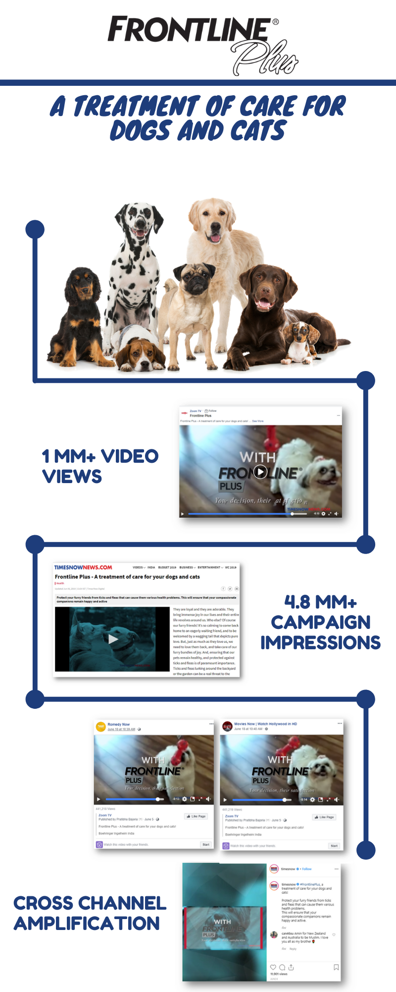
CASE STUDY 3
FRONTLINE PLUS
CAMPAIGN IDEA: – BRAND AWARENESS ABOUT FRONTLINE PLUS AS A TREATMENT CARE FOR PETS
CLIENT: BOEHRINGER INGELHEIM
SITUATION
As a digital first campaign, Pratibha was assigned to lead the entire content and media pitch with the sales team to provide optimal digital solutions
In this scenario, there was lack of social media outreach of animal/pet community as compared to the competing proposals that had a fan base of such niche communities and relevant target audience
TASK
Pratibha transcended the media strategy by using Bollywood and English Entertainment vertical and providing video based solutions like using celebrity content/producing pet grooming videos with an existing follower base of 15 mm +, thereby targetting and reaching the potential audience on Facebook of 52 mm
ACTION
RESULT
As a result,the deal was closed at a profit margin of 55%, garnering 1 mm+ video views of the content created

Slide 8
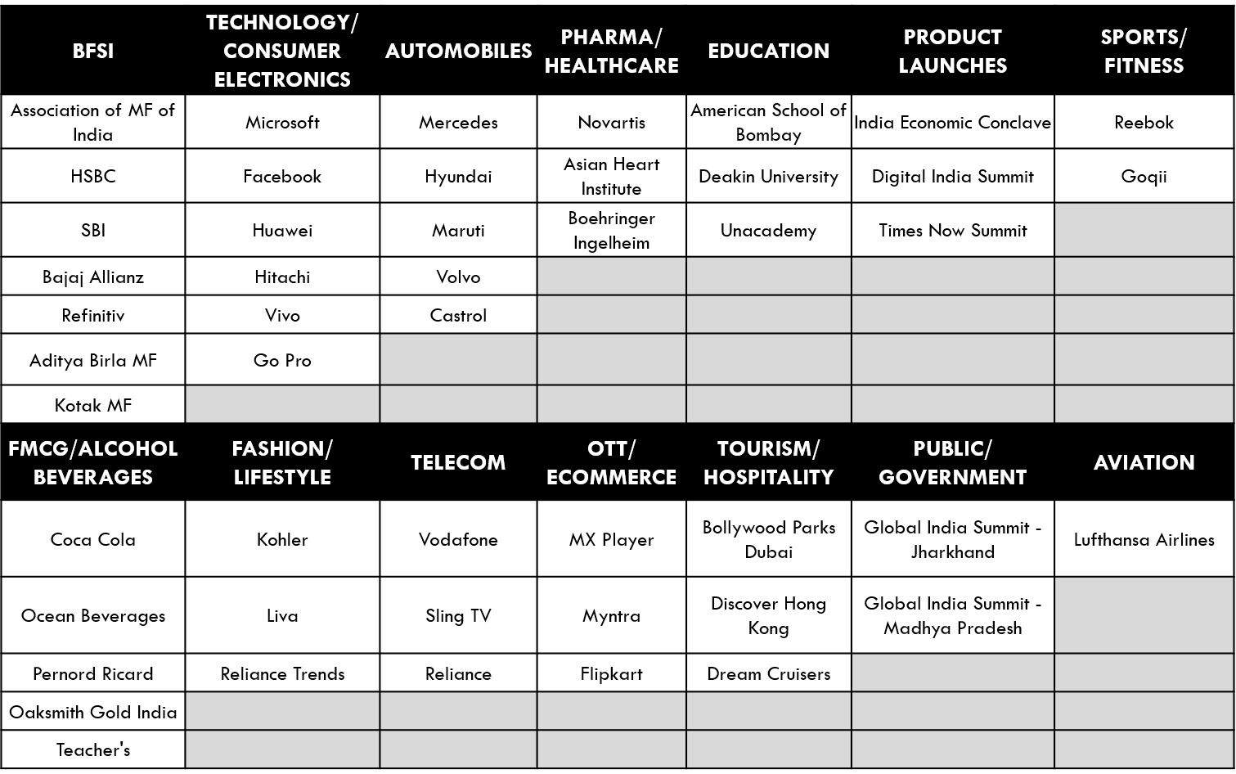
FEW MORE REFERENCES
Brand Campaigns are associated across different marketing assets ranging from social media, Display & Impact Inventory, Video Solutions, Webinar, Events, Influencer based, Content Marketing.
Nearly 60% of the exposure is on global brands across sectors for the local markets aligned with their global objectives.
The campaign objectives were largely product launches, brand positioning, brand awareness, performance growth and consumer engagement.

Slide 9
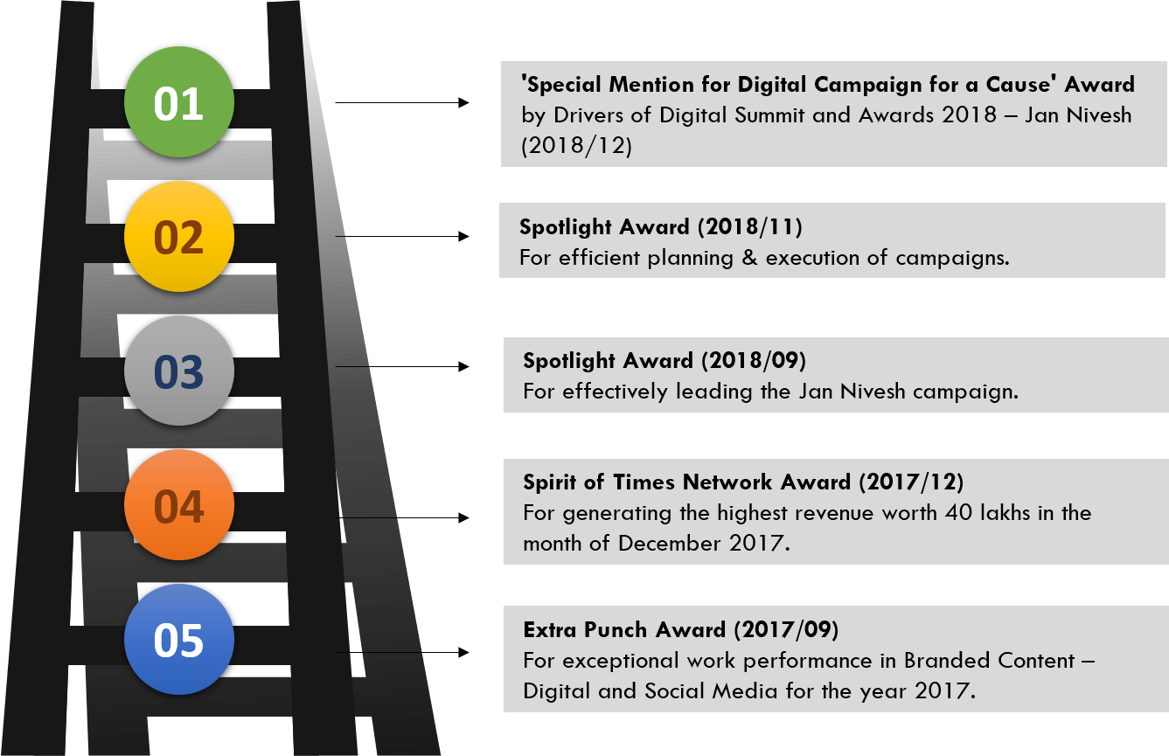
AWARDS AND ACHIEVEMENTS

Slide 10
WHY SHOULD YOU HIRE PRATIBHA?
Hard work, pro-activeness and flexibility are her key strengths that inspires her to methodically execute her work with utmost sincerity and dexterity.
The focus is to keep honing new skills for self-improvement and deliver the best results for the organisation.

Slide 11
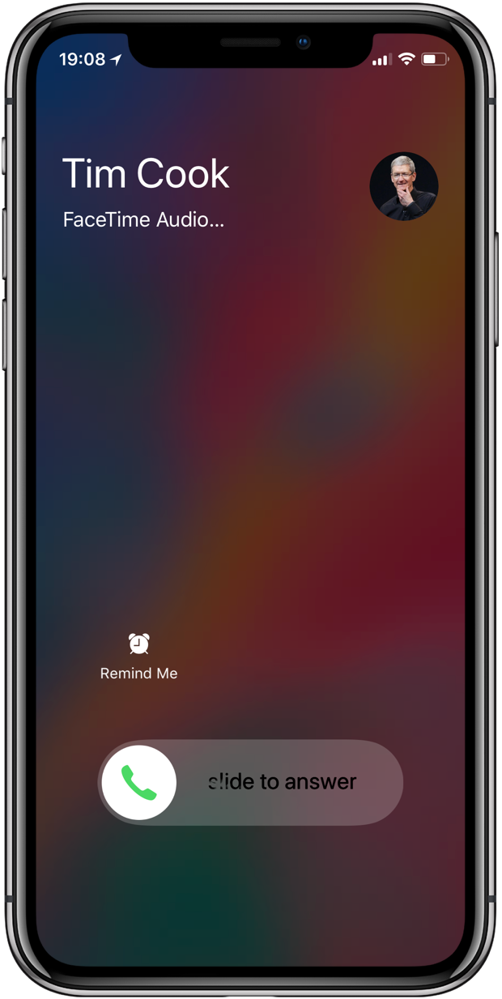
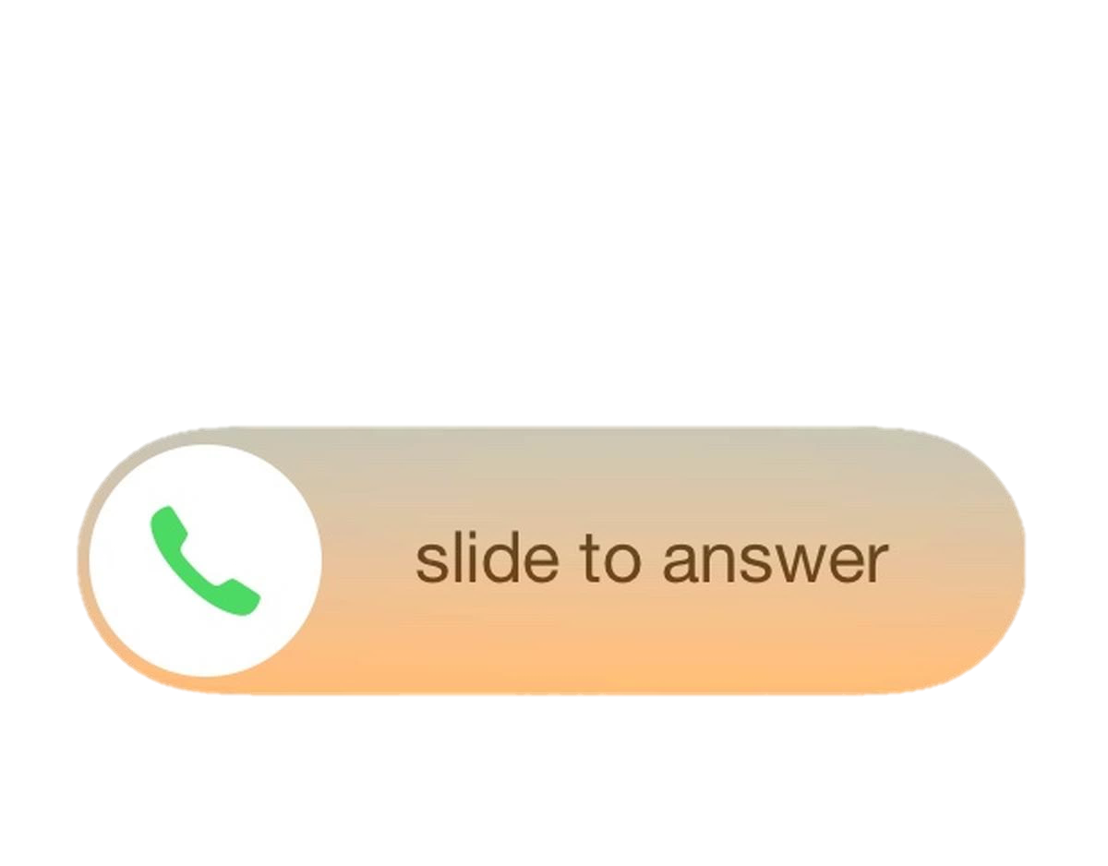
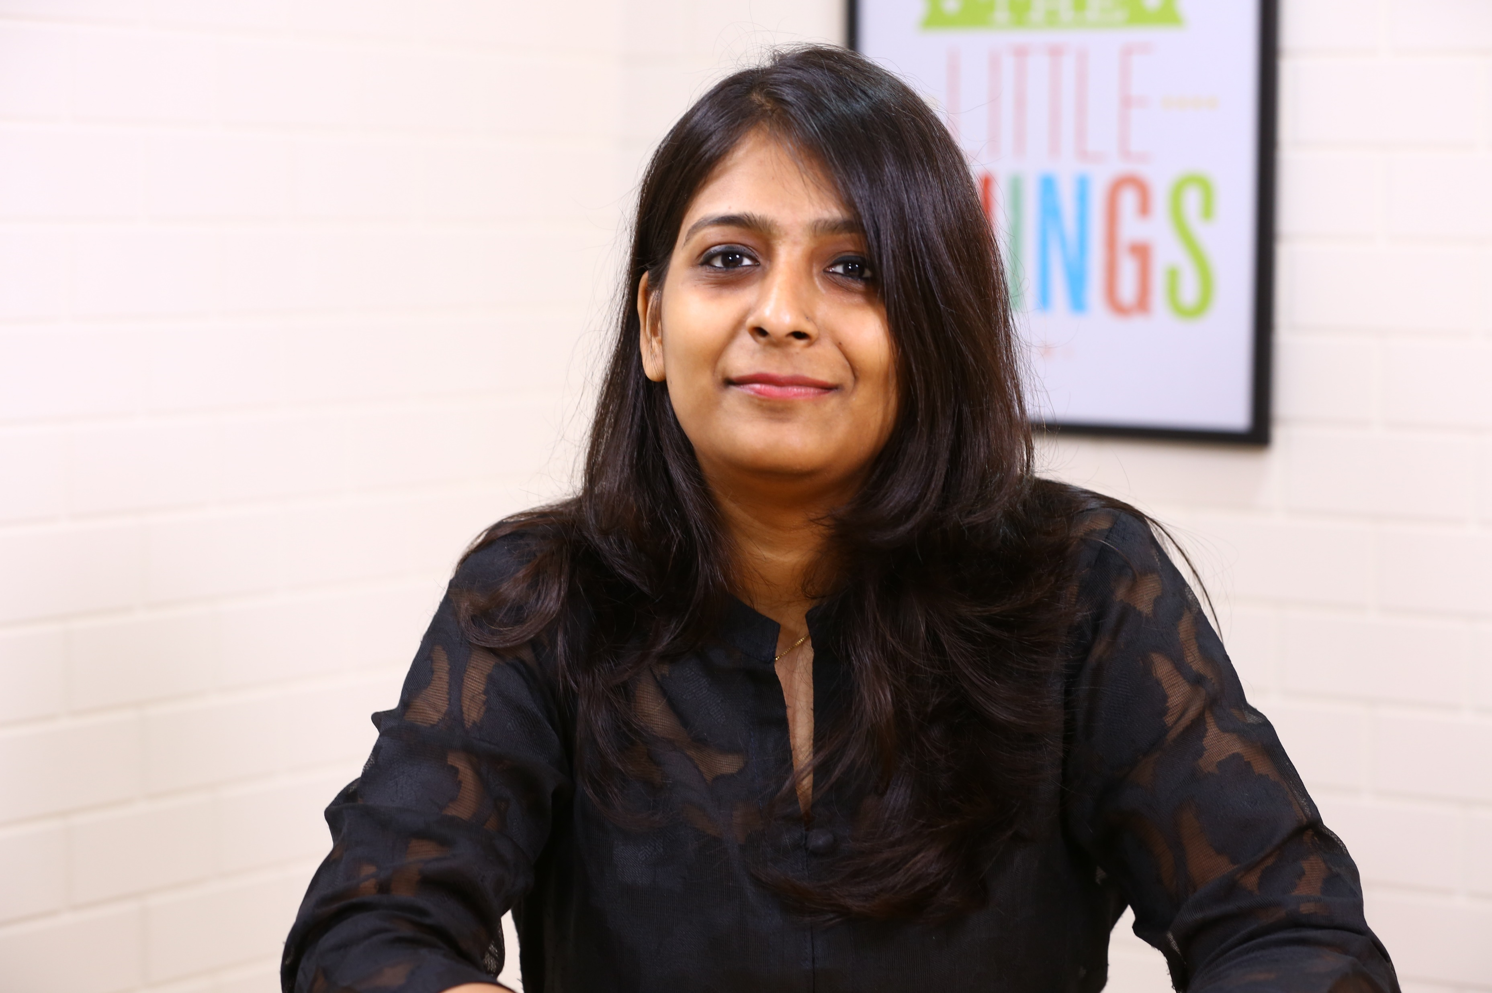
LET’S CONNECT !!
Pratibha
PHONE NO: +91 9874091382
EMAIL ID: pratibha.bajoria30@gmail.com

